Slide 1

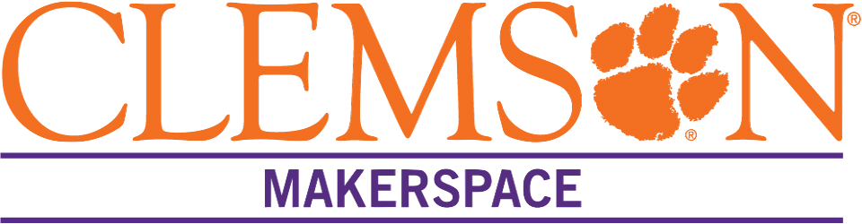
CPSC 4910
Midterm Presentation
+
Josh Norman, Brayden Fidler, Andy Hsu, Evan Moxley, Reagan Leonard
Notes:
Reagan - Hello everyone! We are the AWS group and we are working with Amazon Web Services to provide a product to the Clemson Makerspace this semester. This presentation is meant to serve as a midterm update on our progress.

Slide 2
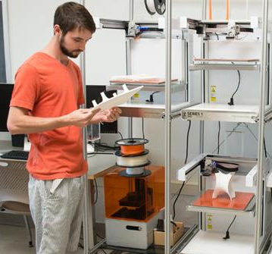
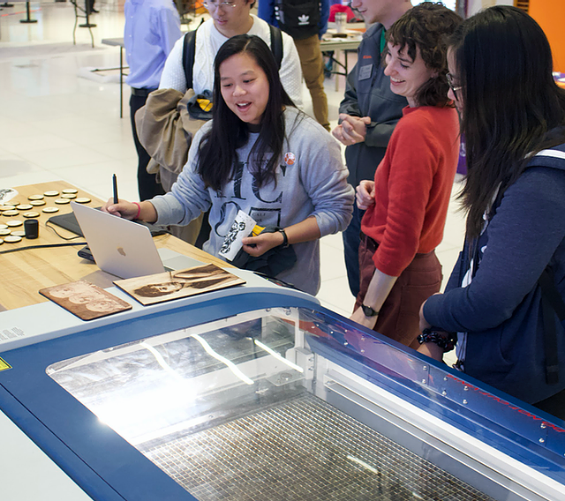
Our Customer: Clemson Makerspace
On-campus fabrication laboratory that has 3D printers, laser-cutters, and other high-tech equipment
Free for Clemson students and faculty to use
Notes:
Reagan - Our customer for this project is the Clemson Makerspace. The Makerspace is a physical laboratory on Clemson’s campus that is equipped with 23 3D printers, 2 laser-cutters, and several other pieces of high-tech fabrication machinery. It was founded in 2015 (by one of our AWS mentors, actually) and has expanded to 2 locations on Clemson’s campus. The use of all machines is 100% free to all Clemson students and faculty.

Slide 3
Project Overview
Implementing a maintenance alert system for Makerspace employees
Proposed System
Old System
Web-based
Push Notifications
Backed up to the cloud
Provides insight
Paper spreadsheet
Notes:
Reagan - So the project we are tasked with for this semester is to essentially digitize the Makerspace’s maintenance system and add a feature that will alert the “Maintenance Team Lead” if a maintenance task is not completed.
The Makerspace machines need regular maintenance tasks performed on them, some nightly, some weekly, and some monthly. Currently, the Makerspace employees simply look at a printed-out spreadsheet of what tasks are due when and they initial the spreadsheet when they have completed a task. This current solution is disorganized and, most importantly, lacking accountability. The maintenance lead has to physically go to the lab to check the spreadsheet as often as she can to see if any tasks were not completed.
Our solution, however, will be a web-based app that aims to have not only push notifications that will elevate a task to the maintenance lead if left incomplete, but also proactive reminders to the employees to ensure they complete the tasks before they are due. We will also keep records of task completions to help provide insight into the Makerspace’s overall efficiency, while respecting the privacy of individual Makerspace employees.

Slide 4
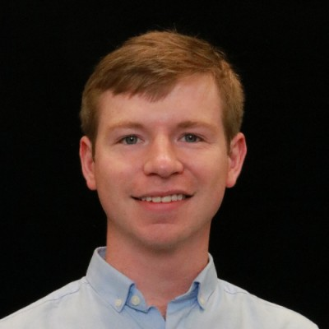
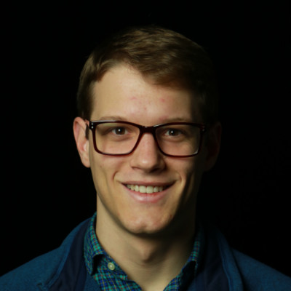
Our Client
AWS Services
Amazon CDK
Mentors
Amazonian way
PRFAQ
Design Doc
Notes:
Reagan - Our client in this project is Amazon Web Services, or AWS for short. They are the company who is actually funding the production of this system to deliver to the Makerspace. We are planning to use 100% AWS-provided/approved services to implement our system, the primary one being the Amazon Cloud Development Kit (or CDK). Per AWS’s website, “The CDK is an open source software development framework to model and provision...cloud application resources using familiar programming languages.” In essence, it is the platform on which we are building our application.
Pictured on the right are our 2 AWS mentors, Owen and Miller, who are both Clemson graduates who now work for AWS in Seattle and Virginia, respectively. Owen was the founder and president of the Makerspace back in 2015.
They are guiding us along what is referred to as the “Amazonian way” of software development. This includes the creation of a Press Release FAQ document (or a PRFAQ) which essentially outlines the features and benefits of what we want our finished product to be. Then we implement the “working backwards” method, a core tenet of the Amazonian process, to design and create the desired system. We are also working hard on our AWS Design Doc which is a thorough design document that is completed as part of every AWS software project.

Slide 5
Our Progress
Sept. 18
Milestone 1
Begin first sprint: Start research and project design
Oct. 2
Milestone 2
Finish Interactive Wireframe Designs
Oct. 9
Milestone 3
Finish Backend UML and Architecture Designs
Oct. 30
Milestone 4
Maintenance Queue Deployment, Design Doc Completion, and Main Page Deployment
Notes:
Reagan - Highlighted in purple here are the milestones that we have already completed in our project and in gray underneath are our upcoming milestones.
As you can see in Milestone 2, we just recently completed our interactive Wireframes of the system UI and I’ll let Josh talk a little bit more about those.

Slide 6
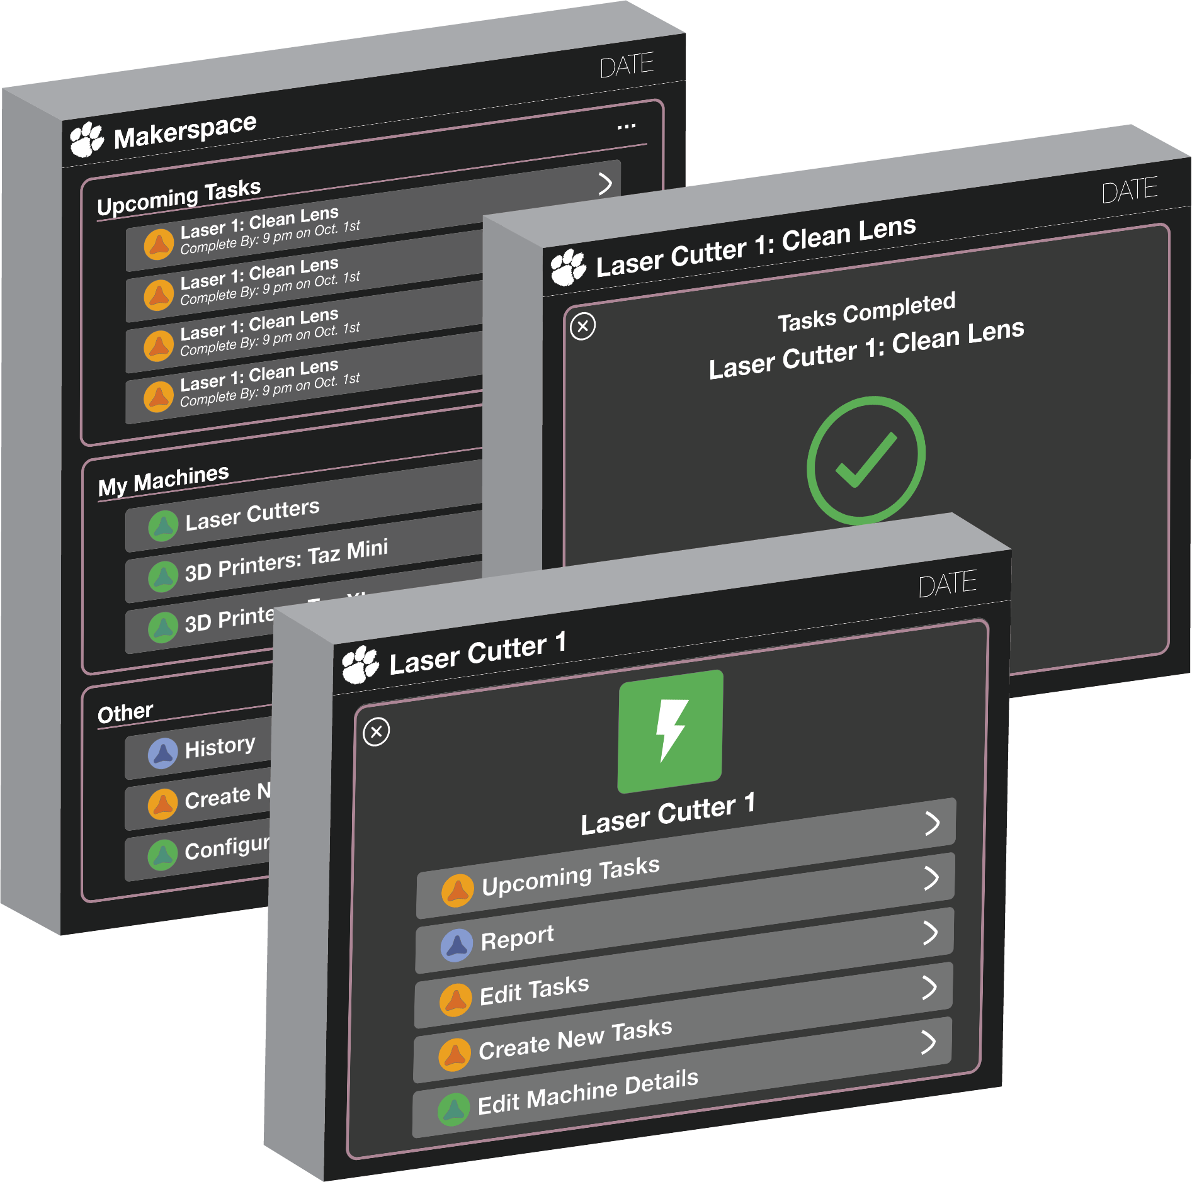
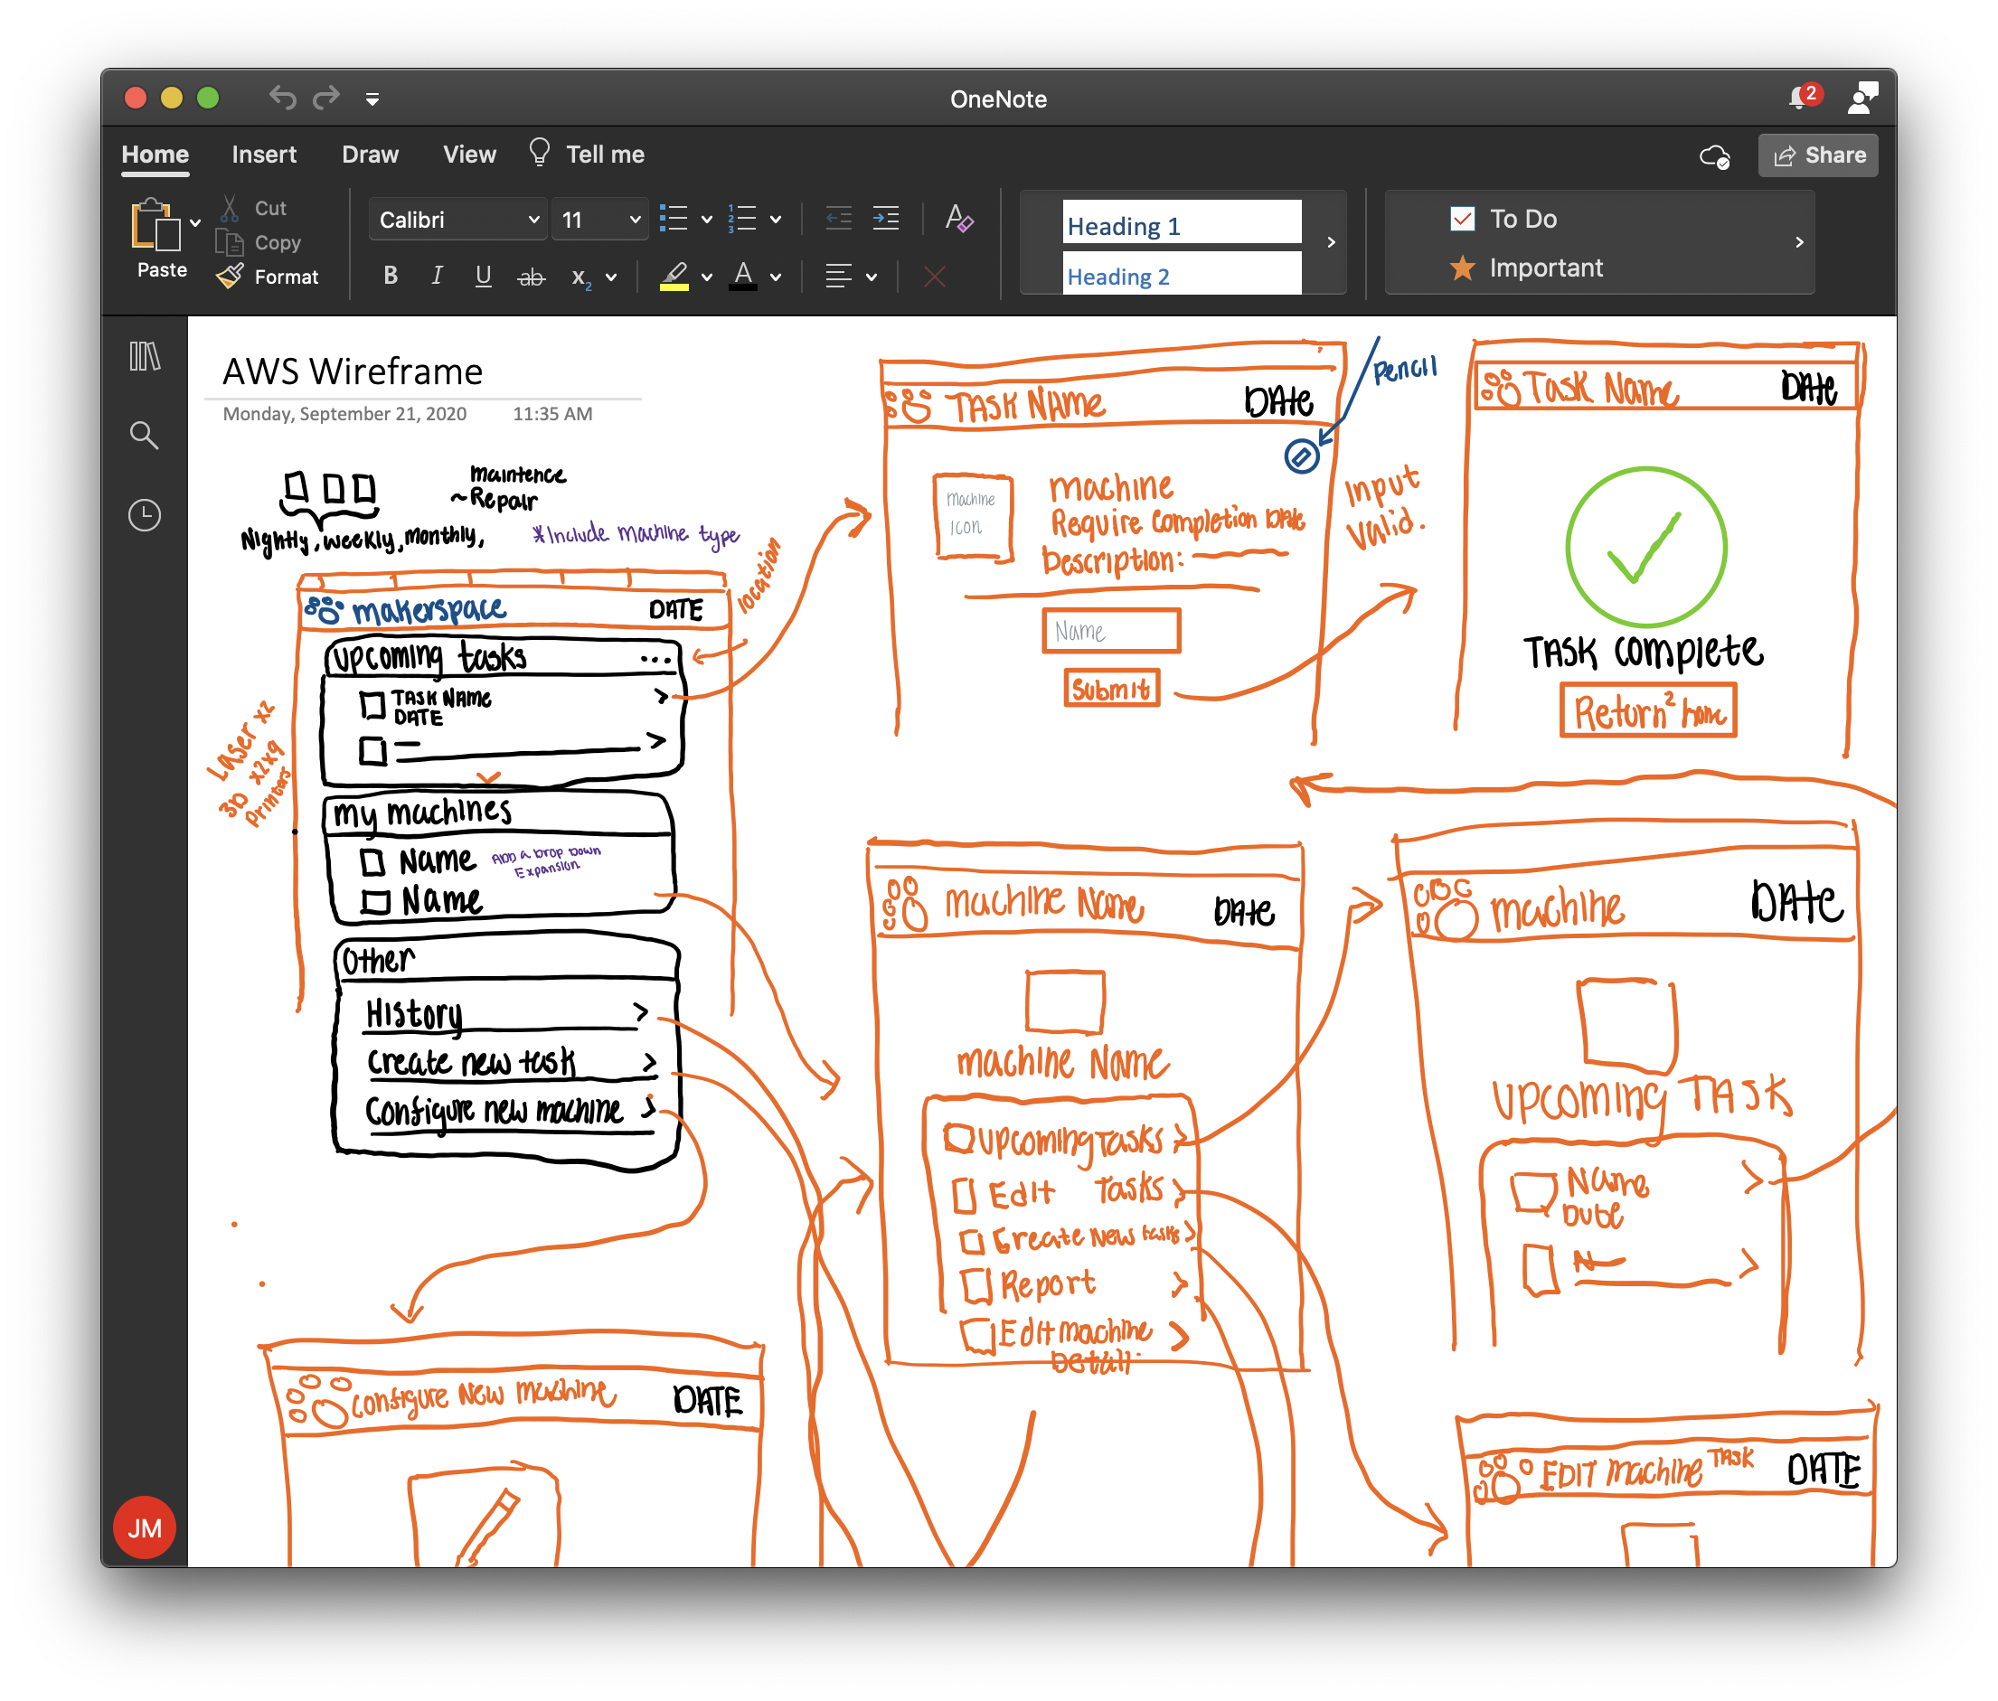
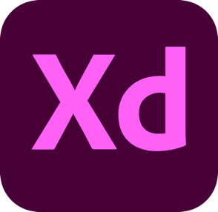
Wireframe Design
Notes:
Josh:

Slide 7

Demo
Notes:
Josh

Slide 8
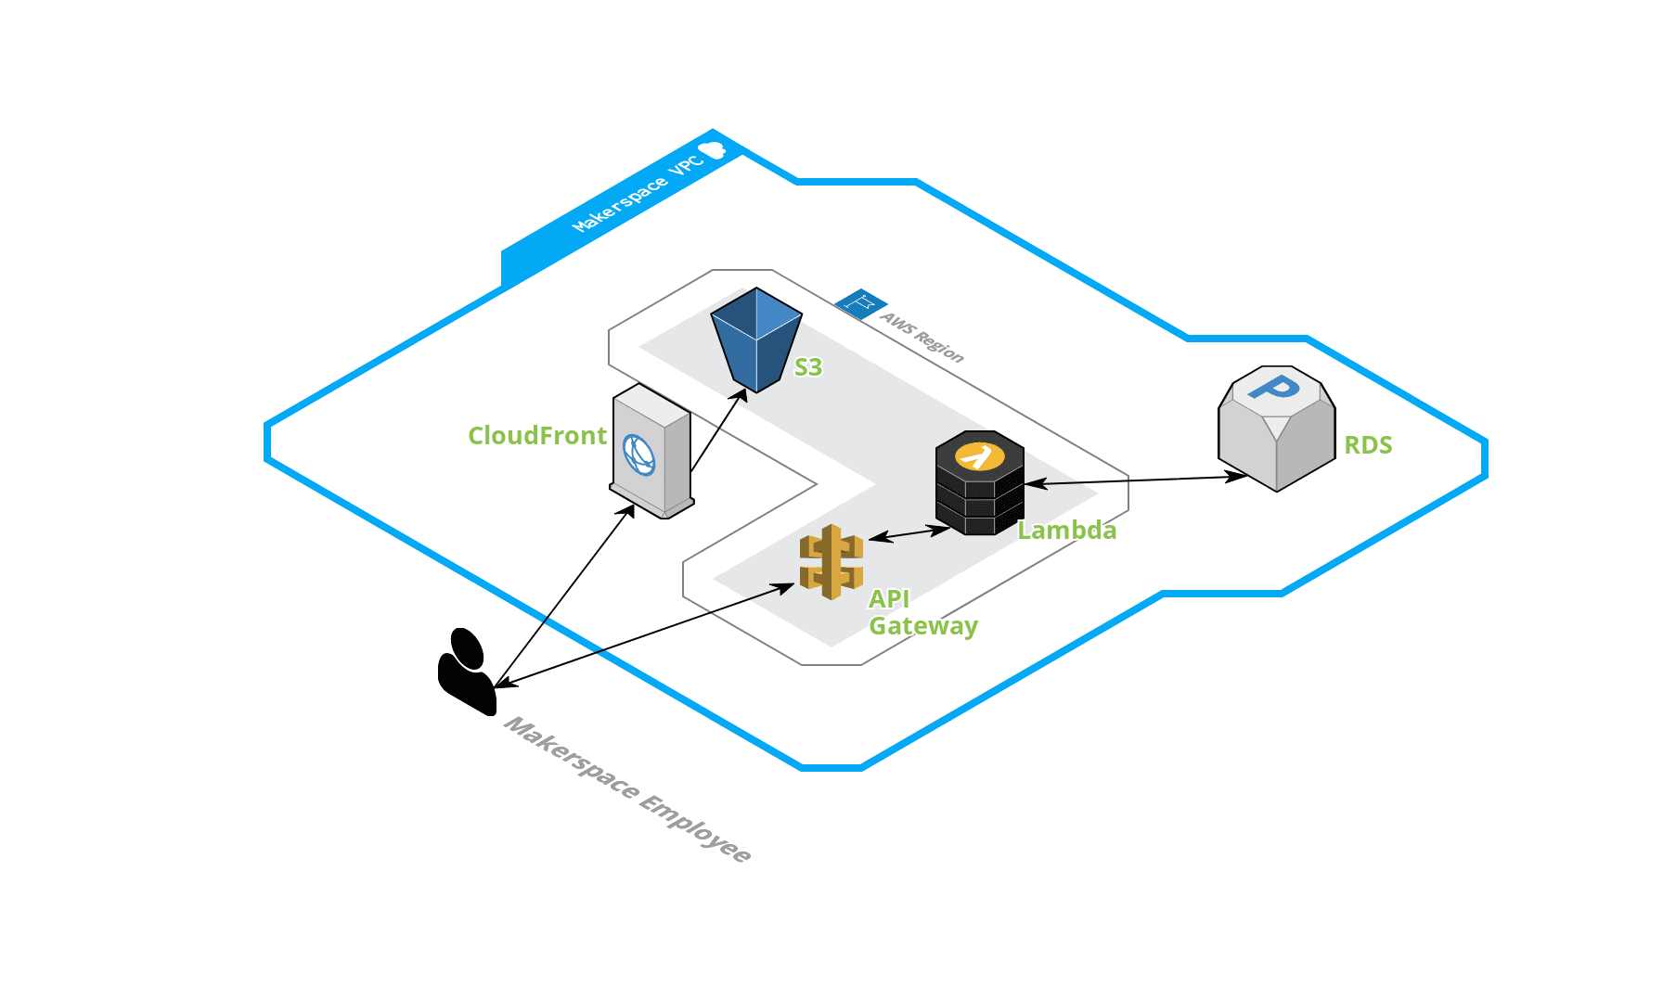
Cloud Architecture
Notes:
Josh:

Slide 9
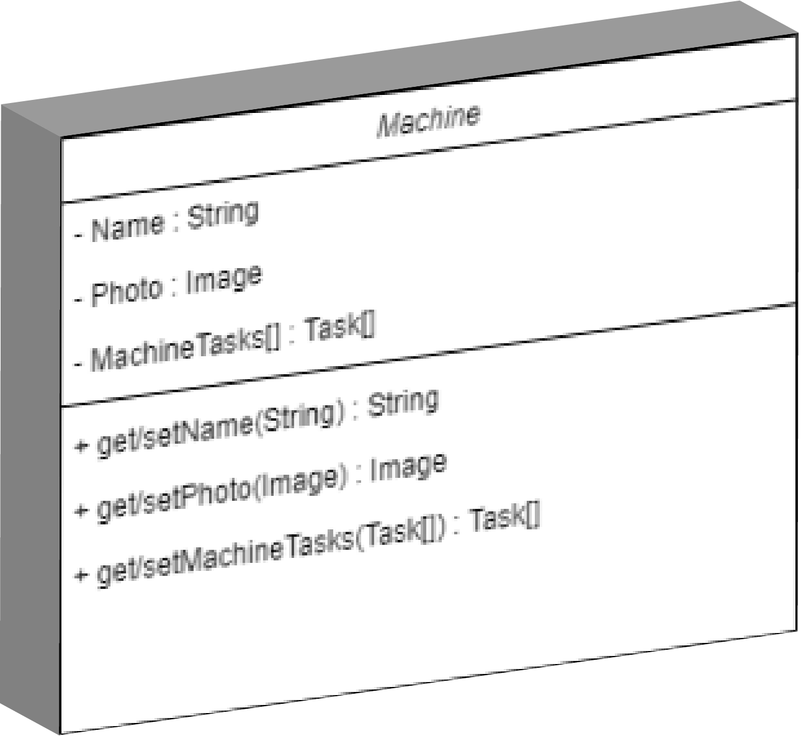
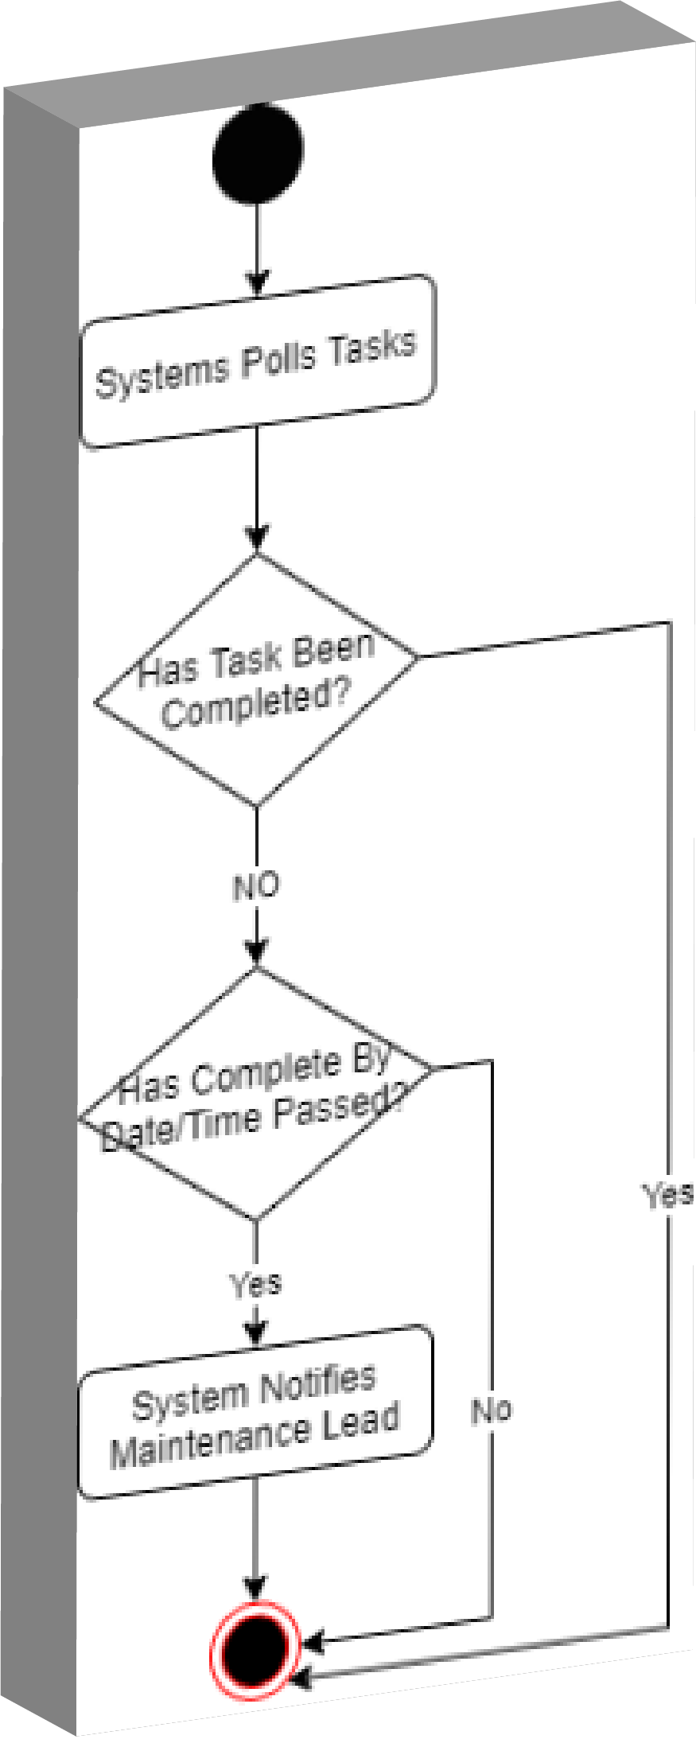
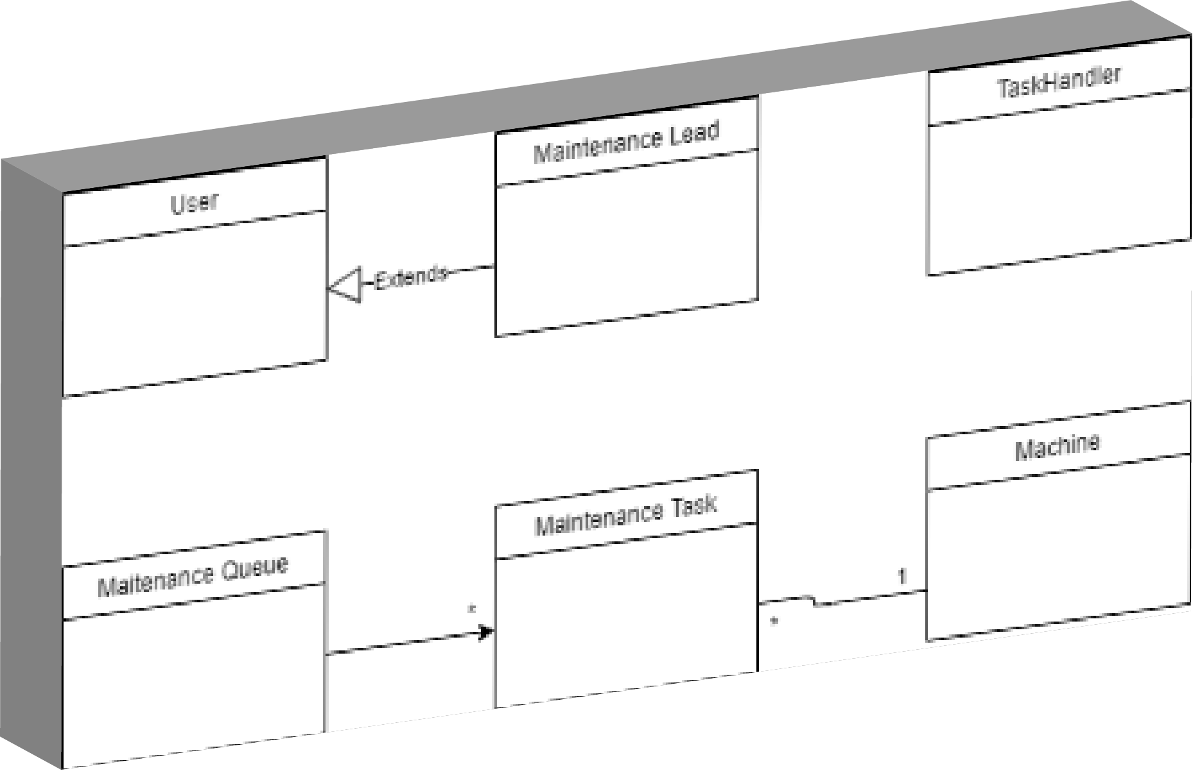
UML Diagrams
Class Diagrams
Class Relationships
Activity Diagrams
Notes:
Brayden:
Primary Backend Milestone = Diagrams the “nuts and bolts” of the system.
Why? Forces decision making and simplifies process of coding
Class Diagrams = 5-6 Class Objects (Building blocks of project)
Key components of a Maintenance System: Machine (Equipment), Maintenance Task, Maintenance Queue (Task Schedule)
Machine Class: Fields and Methods (what it is/what it can do)
Activity Diagrams = visual representation of code functions/like a workflow
Notify Lead Activity:
System polls tasks. Tasks that are incomplete and have passed Due Date lead to notification.

Slide 10
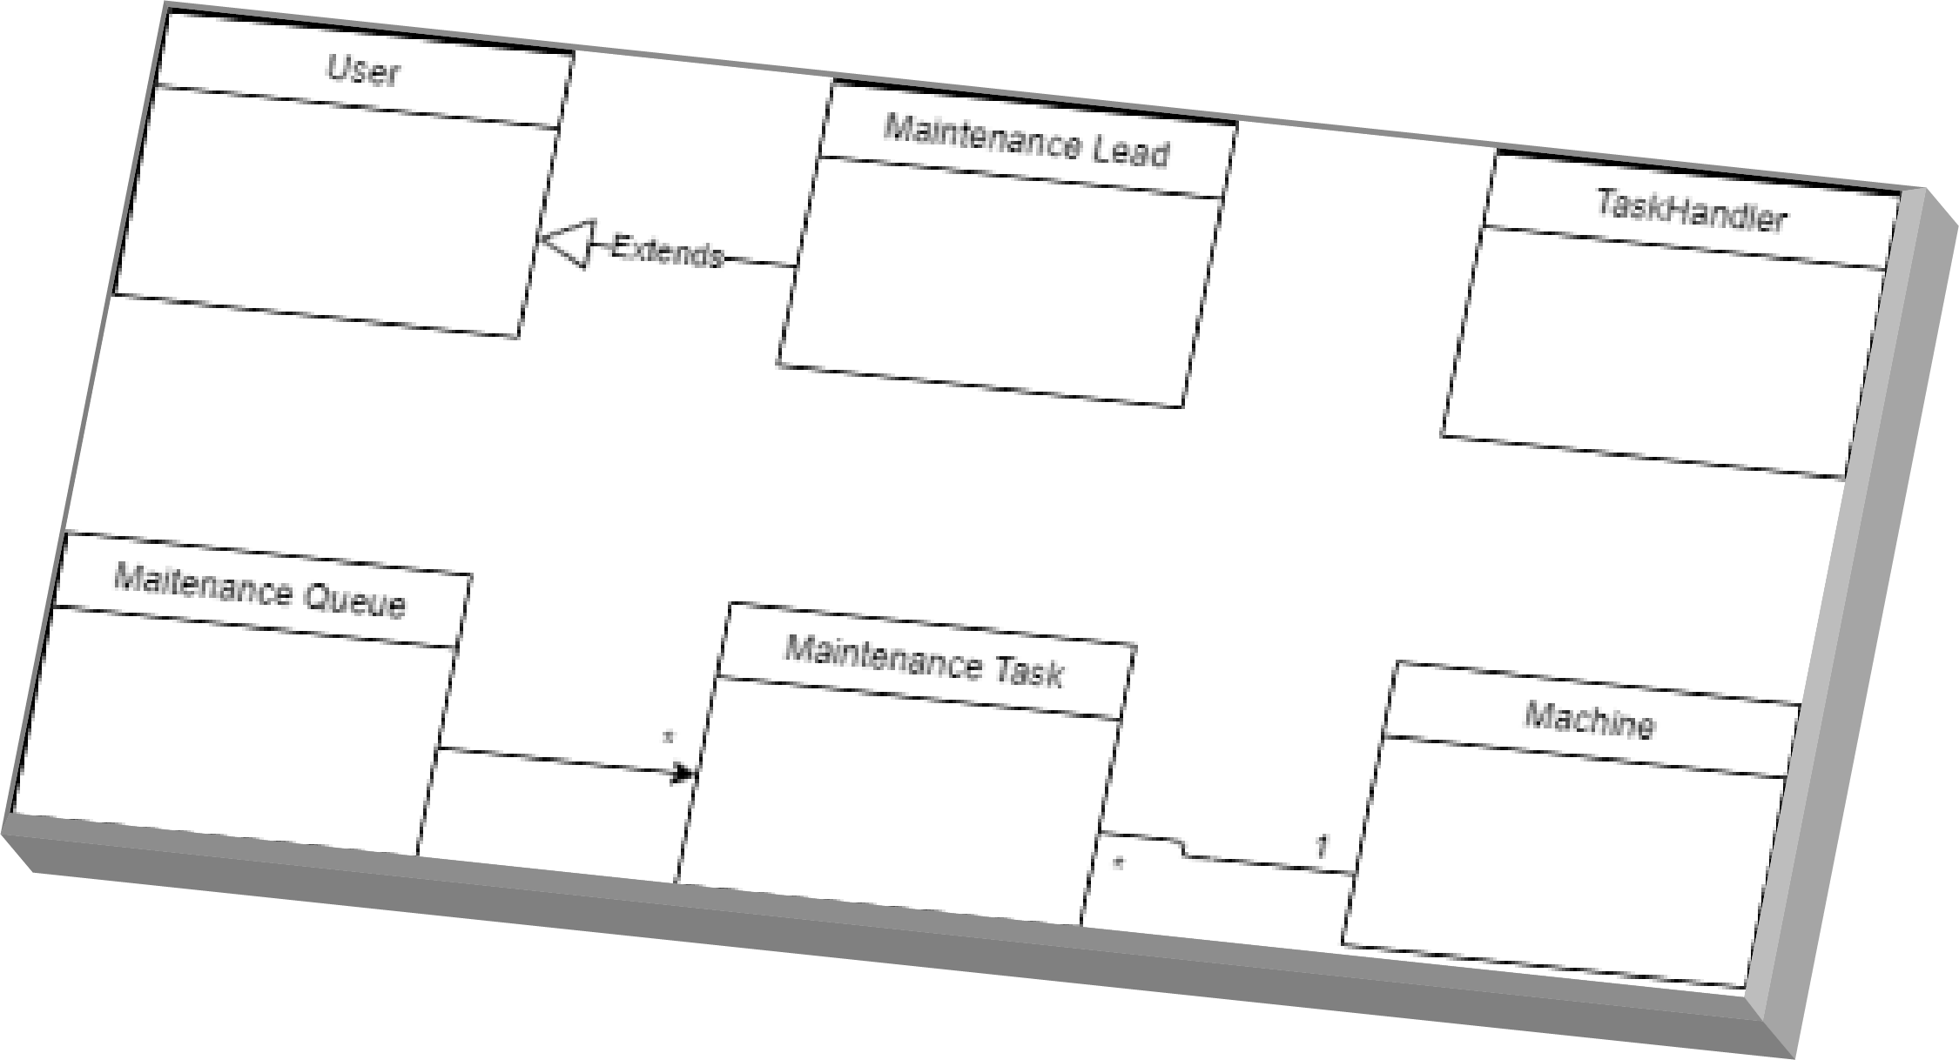
UML Diagrams (Class Relationships)
Notes:
Brayden:
Class Relationship:
Multiplicity between Tasks, Machines, and Queue. Multiple Tasks in queue. Each machine as several tasks while each task is done on a single machine.
Lead extension of normal user privileges.
Both teams have had success thus far, but we have encountered a few challenges → Andy

Slide 11
Challenges
Adobe XD learning curve
AWS CDK familiarity
Team communication (COVID)
Uniqueness of project (client vs. customer)
Notes:
Andy
Adobe XD is Adobe’s response to Sketch. Both software are vector graphics editor. Due to its variety of tools, its complexity is quite high. For those who ever opened Photoshop before, do you remember the first time? Adobe did not make this software beginner friendly either. Therefore, the same learning curve applies here.
AWS CDK is Amazon’s cloud development kit. It is an environment that none of us familiar with before. Initially when we first began, those of us who use Windows machines as the main OS to program, it was difficult to get around permission errors. After that hurdle, we had to familiarize ourselves with the CDK as a whole, and we’re hoping to start implementing the program in the near future.
All group projects have the challenge of communication as one of their greatest stumbling blocks. And in this time of COVID-19, meeting as a team and collaborating on a software project is made even more difficult by the fact that we cannot share our ideas in person.
Our project is very unique in that our client and our customer are not the same. Our client, AWS, is the company that we are working with and they are the ones mentoring us throughout the project. However, the customer that we are actually serving is the Makerspace so it is their feedback that truly matters most and we have to keep that in mind.

Slide 12
What’s Next
Sept. 18
Milestone 1
Begin first sprint: Start research and project design
Oct. 2
Milestone 2
Finish Interactive Wireframe Designs
Oct. 9
Milestone 3
Finish Backend UML and Architecture Designs
Oct. 30
Milestone 4
Maintenance Queue Deployment, Design Doc Completion, and Main Page Deployment
Notes:
Now that you all have an understanding of what our project is and what we’ve accomplished, I’m going to give a brief overview of what we plan to do next. So the next step in the project is to finalize our backend uml diagrams and overall architecture designs this week. Once this is complete we can move forward to actually implementing the project. We will start writing code on both the frontend and backend, completing the maintenance queue functionality and main page by October 30. We also plan to have our design document fully completed, but one thing to note is that as part of the Amazonian development process, our design document is something that is meant to be worked on continuously and refined throughout the project duration. We hope to finish by this date so there is plenty of time for testing and adapting to potential changes

Slide 13
Questions
+

